Slide 1
Magnetic field oscillation in 3D adiabatic slower system for cold atom physics
Yu Lu (Graduate student, Department of Physics, University of Texas at Austin)
Nitish Mittal (Graduate student, College of Pharmacy, University of Texas at Austin)
Xingyao Wang (Graduate student, CSEM program, University of Texas at Austin)

Slide 2
Introduction
Adiabatic slower
used to slow atoms from ∼ 500 m/s down to ∼ 0 m/s
consist of hundreds of overlapping Anti-Helmholtz coils
creates ultra bright cold atom source in atomic physics
Overlapped magnetic traps with an overlapping time sequence create a trap to slow down atoms.
Magnetic field oscillation during the transition of traps is related to:
lose rate, temperature, density of atoms being slowed

Slide 3
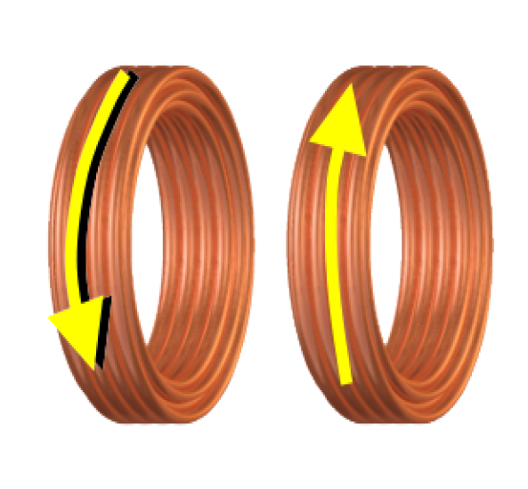
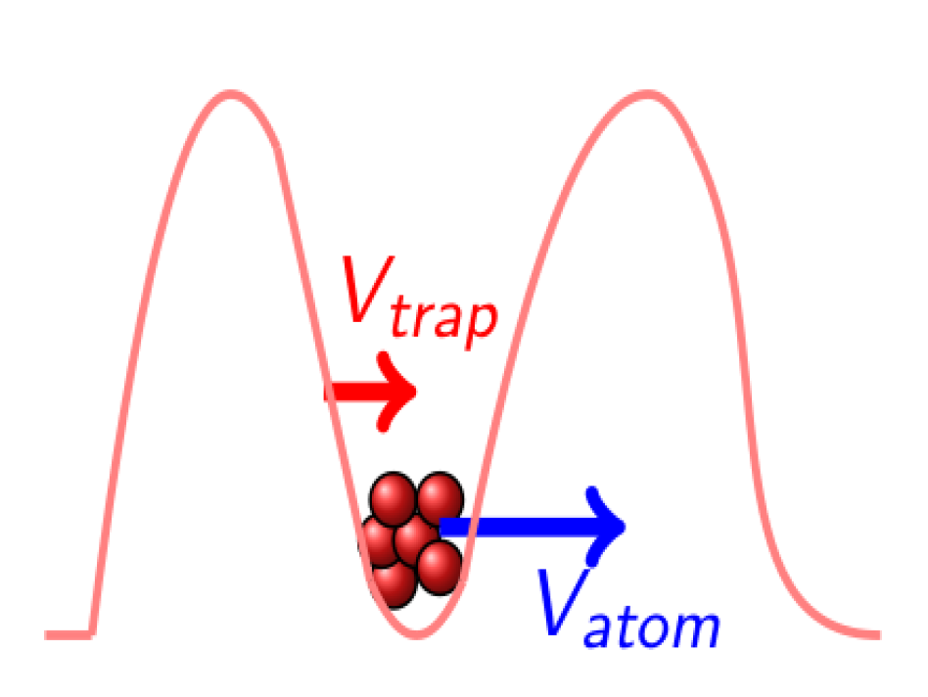
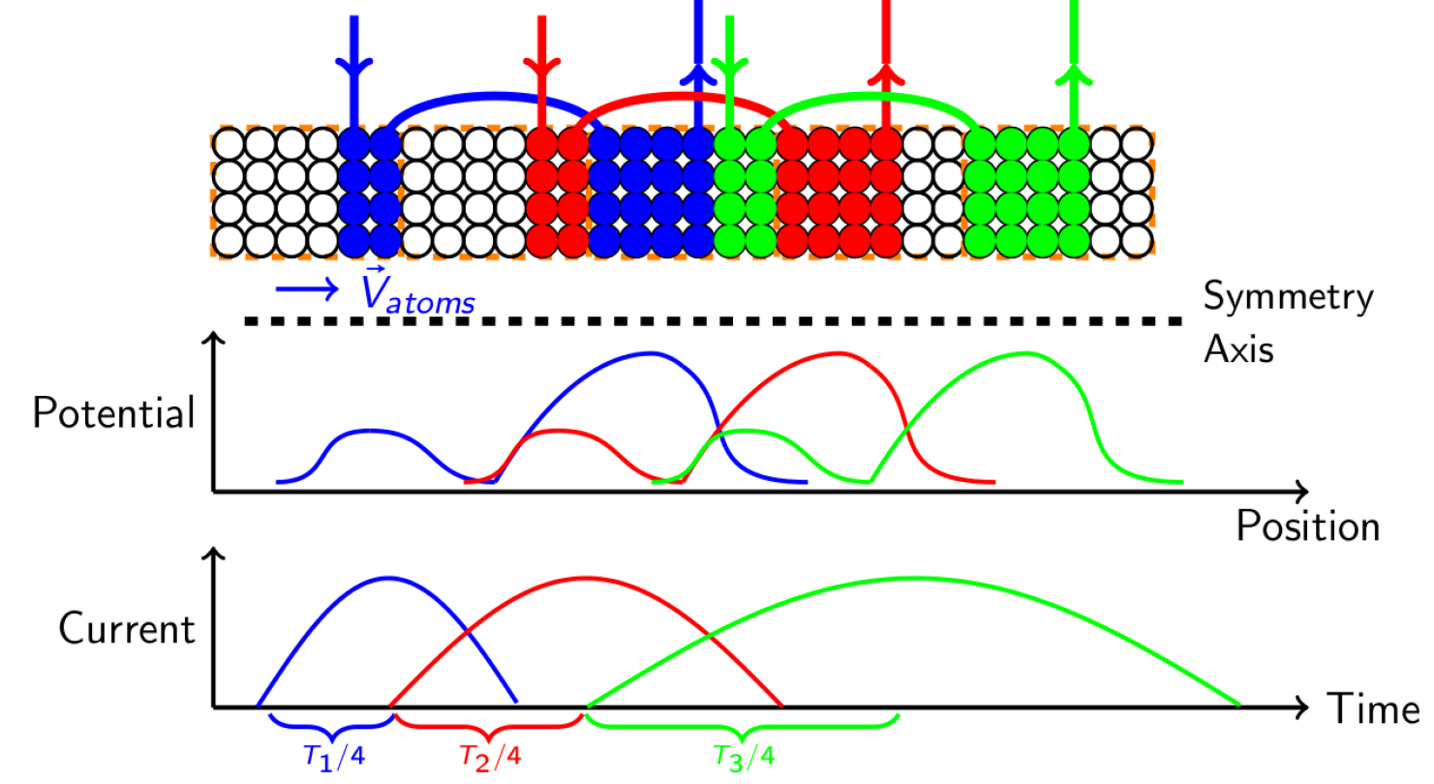
Description
Anti-Helmholtz coil:
a pair of coils with current propagating at opposite direction
provides a confinement of atoms and can be treated as a 'carrier‘
Series of traps activated in overlapping sequence in real space and time creating a moving trap

Slide 4
Objective
Total magnetic field minimum oscillates during transition from one coil to the next
Transition oscillation depends on:
Overlapping traps in space
Overlapping on/off sequence in time
Current pulse shape (e.g. sin wave, triangle wave, etc.)
Anti-Helmholtz coil geometry
Simulate the transition of atoms from magnetic traps to optimize performance

Slide 5
Method
Test different values of operating parameters to minimize oscillation of magnetic fields during transition
Use C++ to encode equations describing the activity of the traps
Create functions to calculate magnetic field values for different times and positions
Construct 3D array to store time, position, and magnetic field values
Write array data to csv file and use python to graph the results

Slide 6
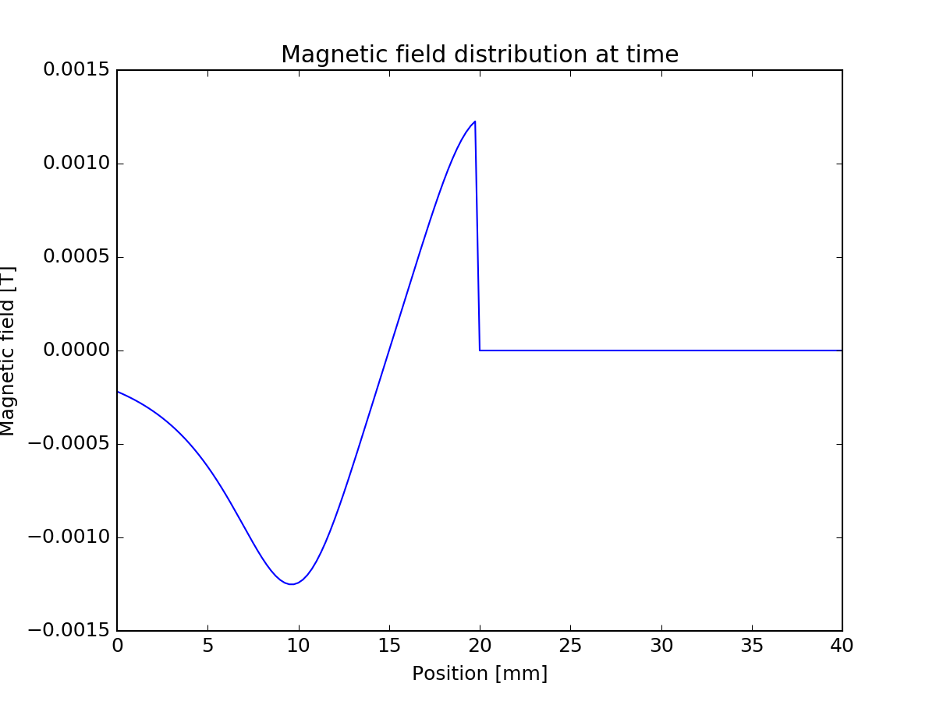
Results

